Slide 1

Localebnb
An Airbnb Contextual Recommender
G Scott Stukey
Notes:
Backgroun an image of my app.

Slide 2
Motivation
When booking a private residence,
how do you find the perfect neighborhood?

Slide 3
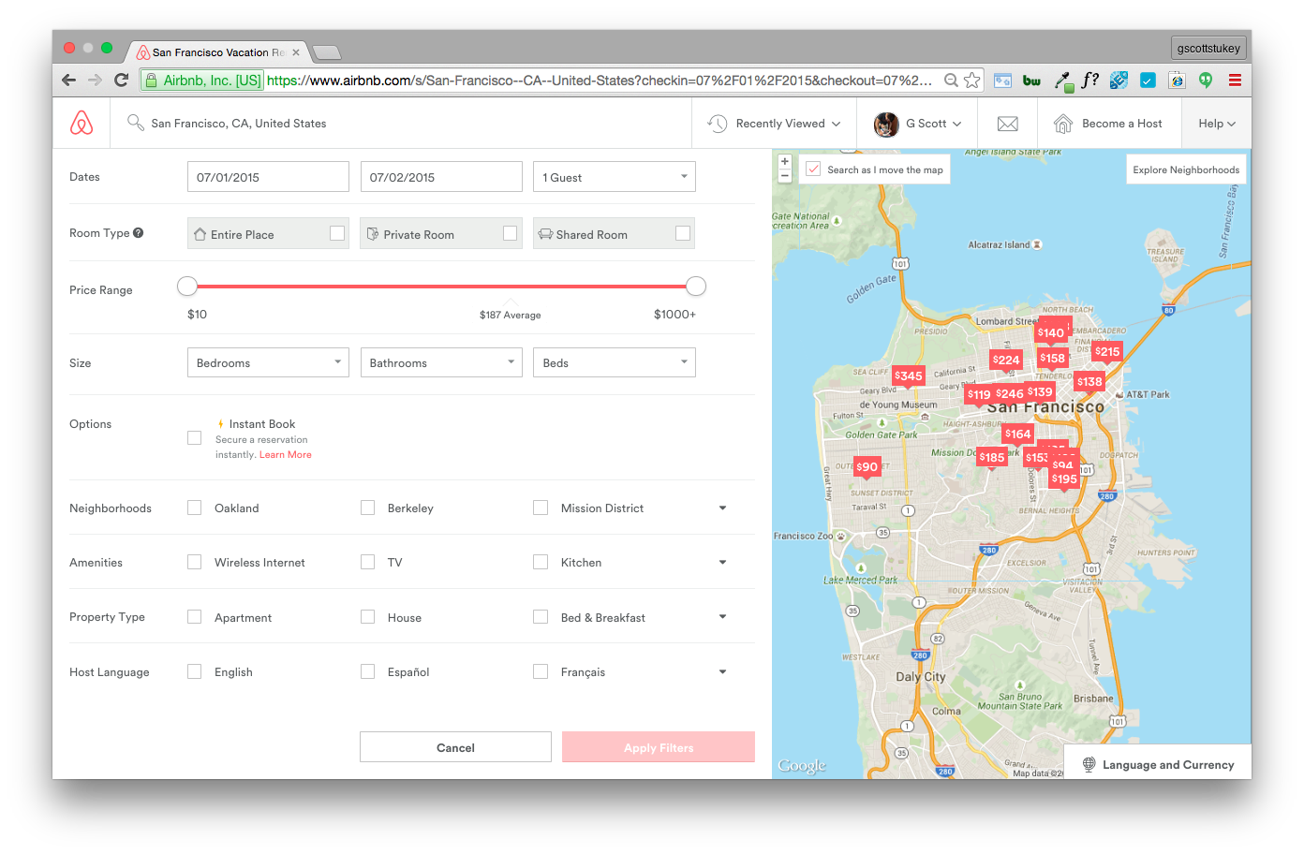
Problem
Airbnb search results
No ability to
search or filter
by trait!

Slide 4
Hypothesis
Use Airbnb listing descriptions to predict neighborhood traits & customize search results to users’ preferences
Why Airbnb should implement this:
Increase user satisfaction by increasing relevance
Increase booking rate by reducing bounces (click fatigue)

Slide 5
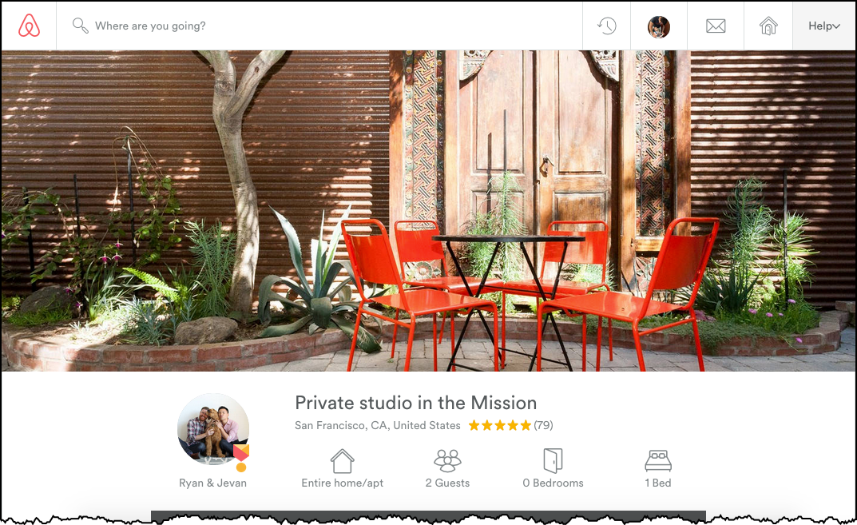
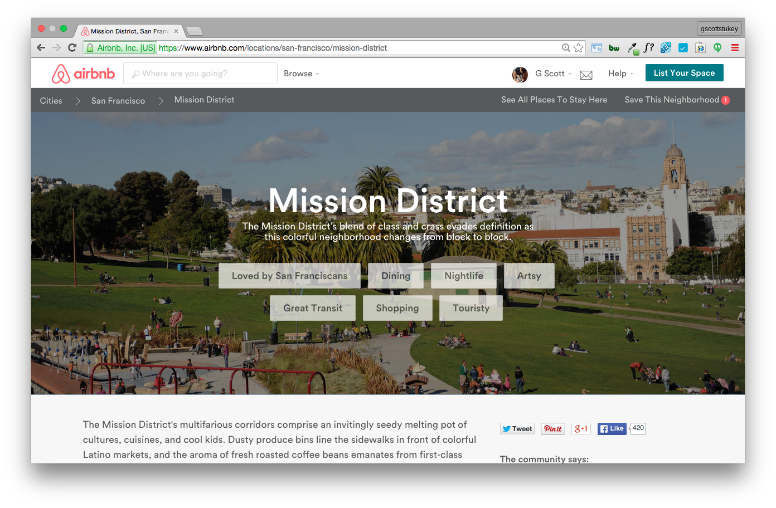
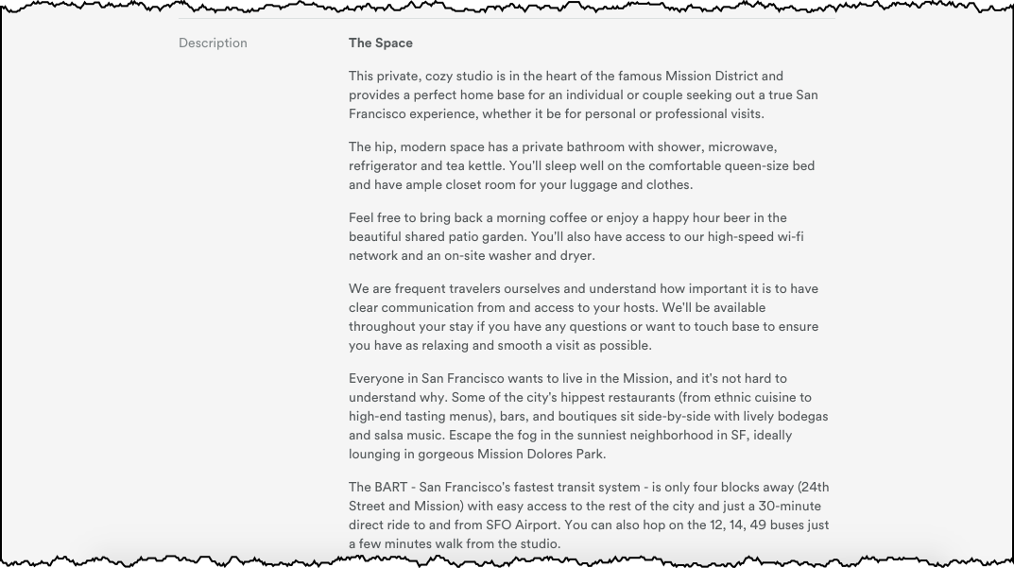
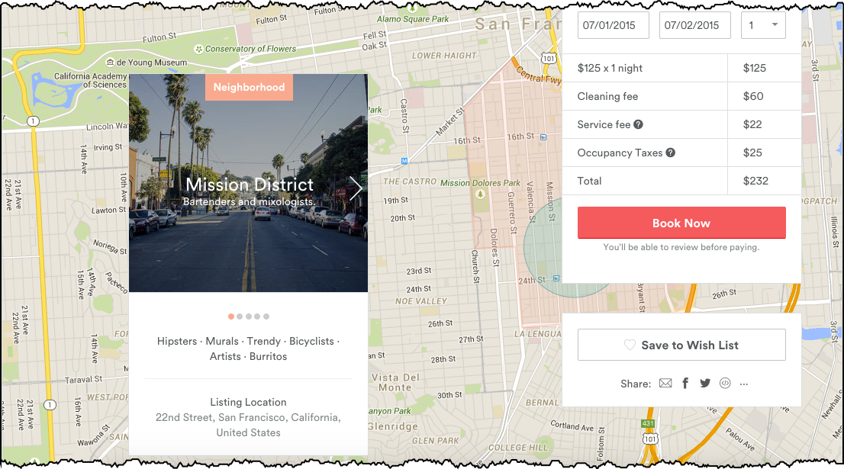
Solution
Listing Page
Neighborhood Guide
Features
Target

Slide 6
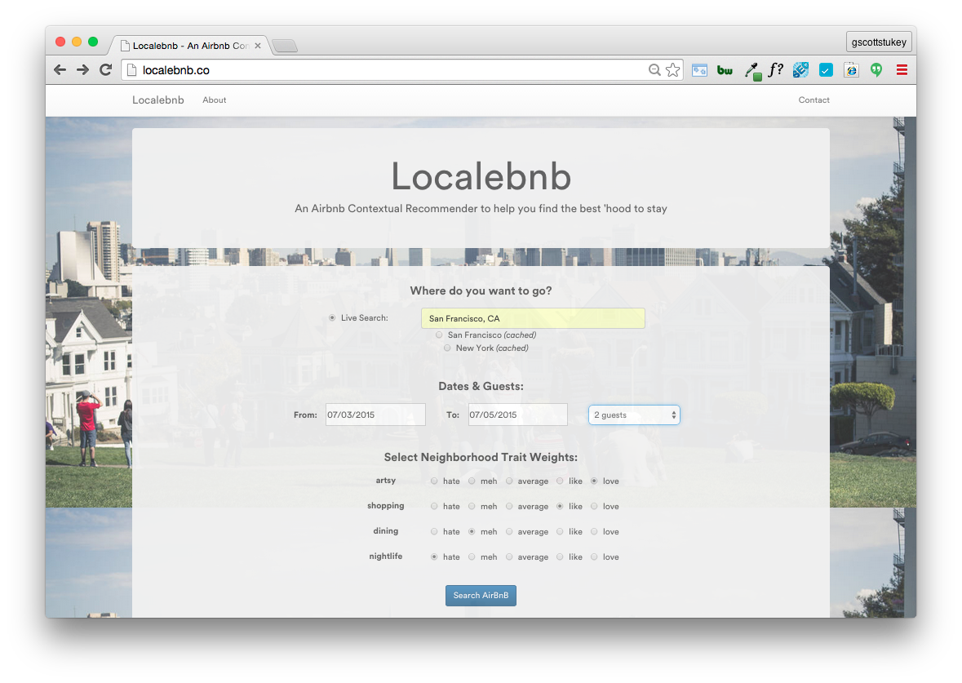

Slide 7
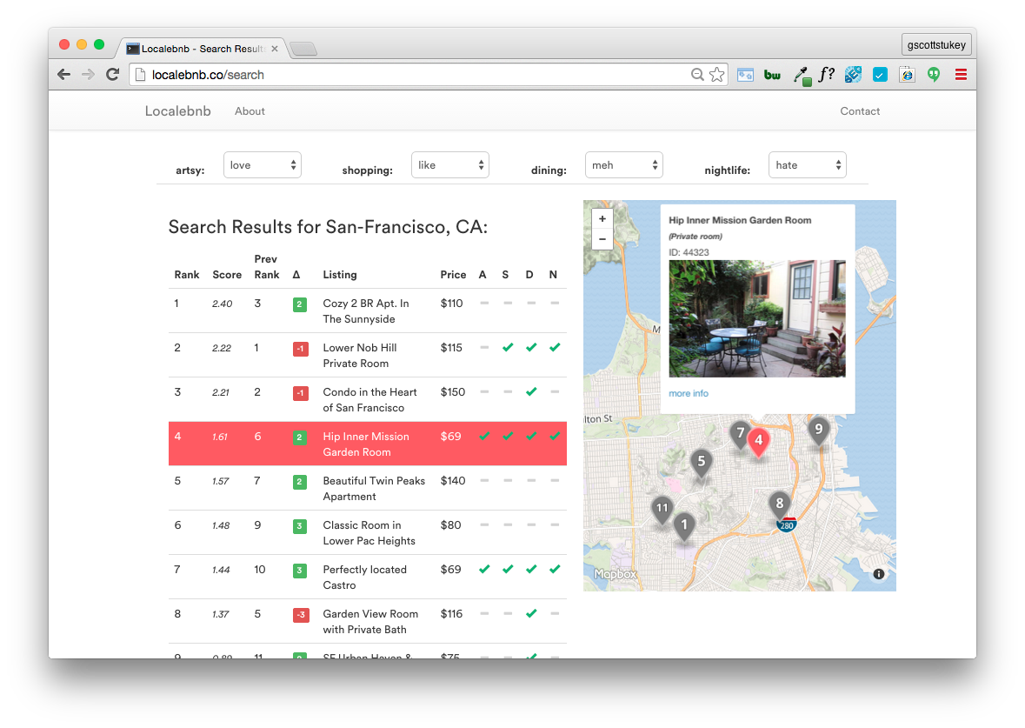
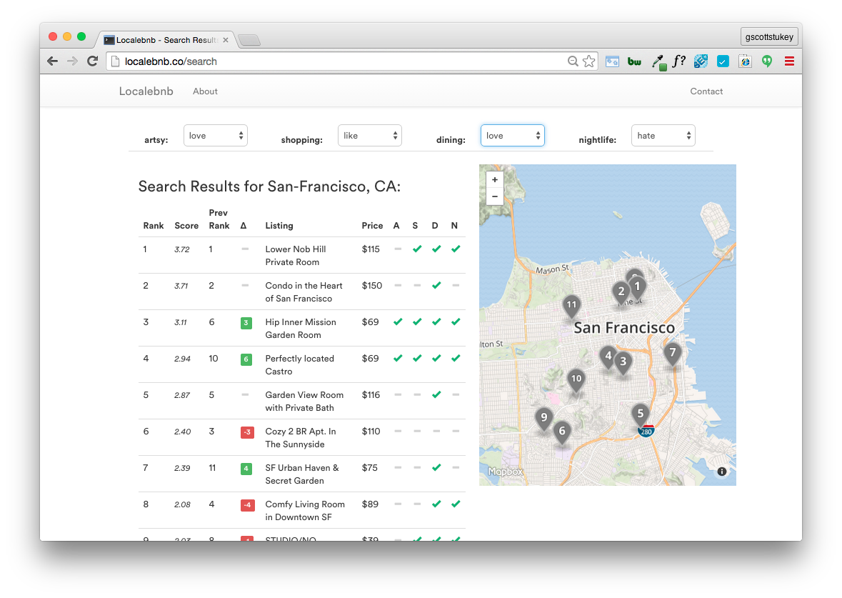
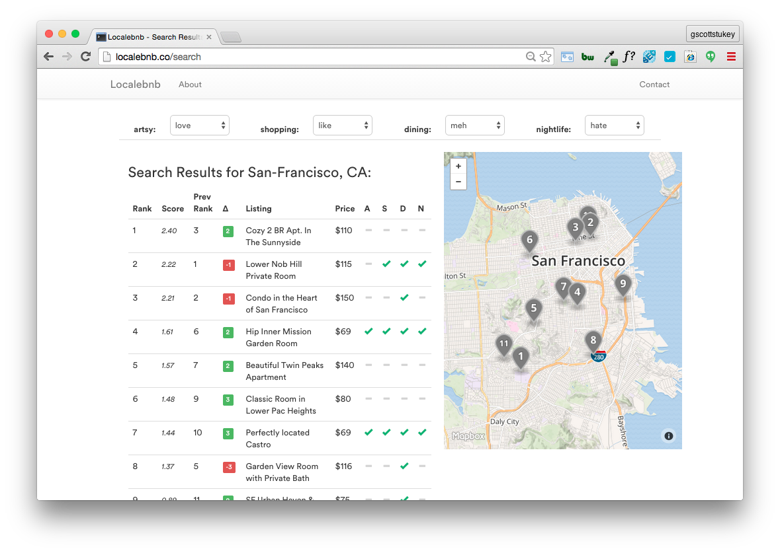
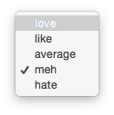

Slide 8
Methodology
Beautiful
Soup
+
ETL
Scraped Listings
Scraped Neighborhood Traits
Prepping
Cleaned Documents (lemmatization, expand contractions, et al.)
NLTK
Modeling
Word2Vec / Doc2Vec
TF-IDF Vectorization
Naïve Bayes
SVM
Random Forest / GBC
Word2Vec
Rank/Sort
Implemented Custom Scoring Function (inspired by Google Search CTR by position)

Slide 9
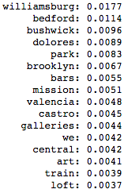
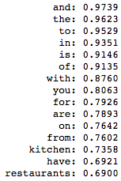
Insights
SVM
Forest
TF-IDF
Infrequent words add value
Neighborhood names dominate feature importance
Airbnb is for foodies
‘artsy’ model key words
doc frequency
78-82% accuracy
5 pt lift over naïve bayes

Slide 10
Extensions
Scrape more descriptions across more cities
Include additional listing information in models
Make neighborhood traits more fluid
Give partial weight to nearby neighborhoods utilizing graph analytics
How Airbnb could benefit:
Guide creation of neighborhood guides in new cities

Slide 11
Thank You
@gscottstukey
Notes:
Backgroun an image of my app.

